Slide 1
Multiple View Geometry and Stereo

Slide 2
Overview
Single camera geometry
Recap of Homogenous coordinates
Perspective projection model
Camera calibration
Stereo Reconstruction
Epipolar geometry
Stereo correspondence
Triangulation

Slide 3
Projective Geometry
Recovery of structure from one image is inherently ambiguous
Today focus on geometry that maps world to camera image
X?
X?
X?
x

Slide 4
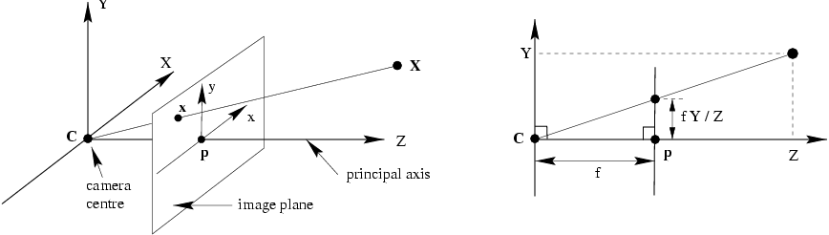
Recall: Pinhole camera model
Principal axis: line from the camera center perpendicular to the image plane
Normalized (camera) coordinate system: camera center is at the origin and the principal axis is the z-axis

Slide 5
Recall: Pinhole camera model

Slide 6
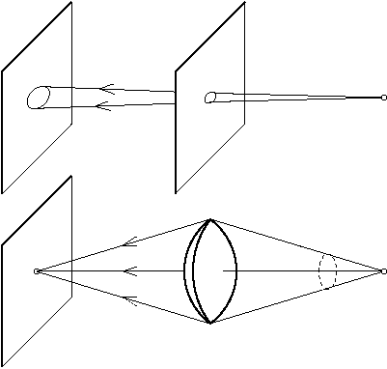
Camera Internal Parameters or Calibration matrix
Background
The lens optical axis does not coincide with the sensor
We model this using a 3x3 matrix the Calibration matrix

Slide 7
Camera Calibration matrix
The difference between ideal sensor ant the real one is modeled by a 3x3 matrix K:
(c_{x},c_{y}) camera center, (a_{x},a_{y}) pixel dimensions, b skew
We end with

Slide 8
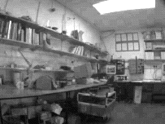
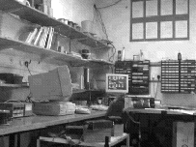
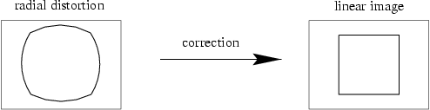
Radial distortion

Slide 9
Camera parameters
Intrinsic parameters
Principal point coordinates
Focal length
Pixel magnification factors
Skew (non-rectangular pixels)
Radial distortion
Extrinsic parameters
Rotation and translation relative to world coordinate system

Slide 10
Scenarios
The two images can arise from
A stereo rig consisting of two cameras
the two images are acquired simultaneously
or
A single moving camera (static scene)
the two images are acquired sequentially
The two scenarios are geometrically equivalent

Slide 11
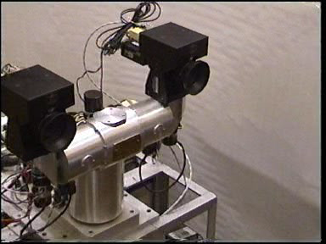
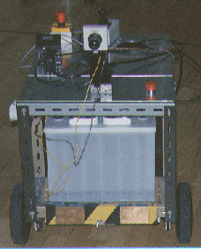
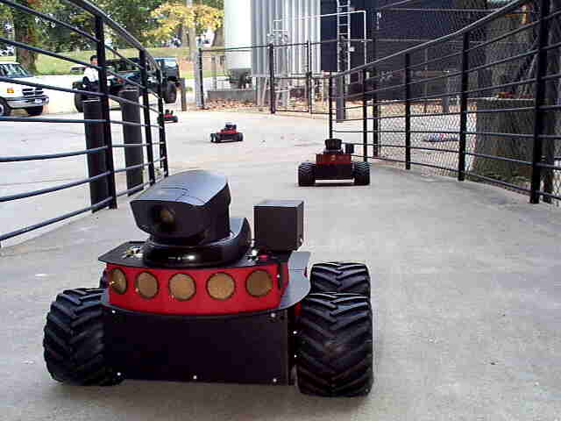
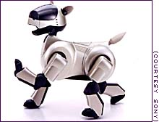
Stereo head
Camera on a mobile vehicle

Slide 12
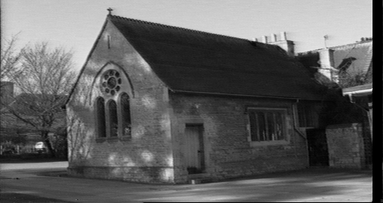
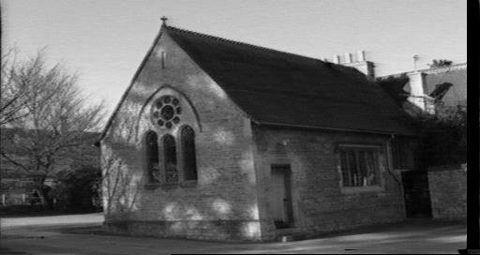
The objective
Given two images of a scene acquired by known cameras compute the 3D position of the scene (structure recovery)
Basic principle: triangulate from corresponding image points
Determine 3D point at intersection of two back-projected rays

Slide 13
Corresponding points are images of the same scene point
Triangulation
C
C
/
The back-projected points generate rays which intersect at the
3D scene point

Slide 14
An algorithm for stereo reconstruction
For each point in the first image determine the corresponding point in the second image
(this is a search problem)
For each pair of matched points determine the 3D point by triangulation
(this is an estimation problem)

Slide 15
The correspondence problem
Given a point x in one image find the corresponding point in the other image
This appears to be a 2D search problem, but it is reduced to a 1D search by the epipolar constraint

Slide 16
Outline
Epipolar geometry
the geometry of two cameras
reduces the correspondence problem to a line search
Stereo correspondence algorithms
Triangulation

Slide 17

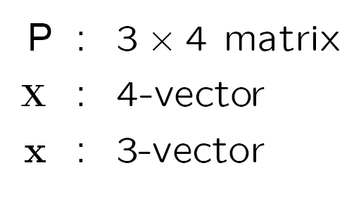
Notation
The two cameras are P and P/, and a 3D point X is imaged as
X
P
P/
x
/
x
C
C
/
Warning
for equations involving homogeneous quantities ‘=’ means ‘equal up to scale’

Slide 18
Epipolar geometry

Slide 19
Epipolar geometry
Given an image point in one view, where is the corresponding point in the other view?
?
epipolar line
C
C
/
epipole
baseline
A point in one view “generates” an epipolar line in the other view
The corresponding point lies on this line

Slide 20
Epipolar line
Epipolar constraint
Reduces correspondence problem to 1D search along an epipolar line

Slide 21
Epipolar geometry continued
Epipolar geometry is a consequence of the coplanarity of the camera centres and scene point
X
x
x
/
C
C
/
The camera centres, corresponding points and scene point lie in a single plane, known as the epipolar plane

Slide 22
Nomenclature
X
l/
right epipolar line
left epipolar line
x
/
x
e
e
/
C
C
/
The epipolar line l/ is the image of the ray through x
The epipole e is the point of intersection of the line joining the camera centres with the image plane
this line is the baseline for a stereo rig, and
the translation vector for a moving camera
The epipole is the image of the centre of the other camera: e = PC/ , e/ = P/C

Slide 23
The epipolar pencil
X
e
/
e
baseline
As the position of the 3D point X varies, the epipolar planes “rotate” about the baseline. This family of planes is known as an epipolar pencil. All epipolar lines intersect at the epipole.
(a pencil is a one parameter family)

Slide 24
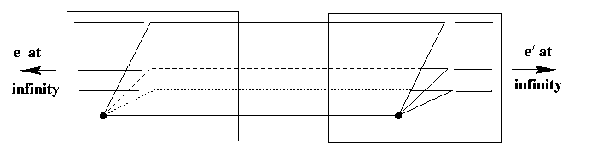
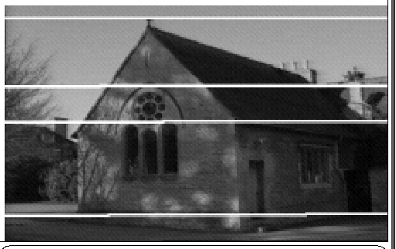
Epipolar geometry example I: parallel cameras
Epipolar geometry depends only on the relative pose (position and orientation) and internal parameters of the two cameras, i.e. the position of the camera centres and image planes. It does not depend on the scene structure (3D points external to the camera).

Slide 25
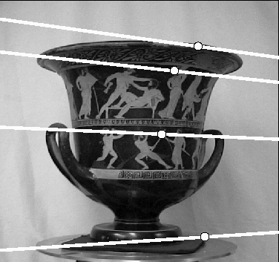
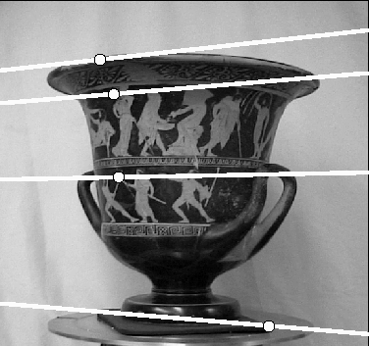
Epipolar geometry example II: converging cameras
e
e
/
Note, epipolar lines are in general not parallel

Slide 26
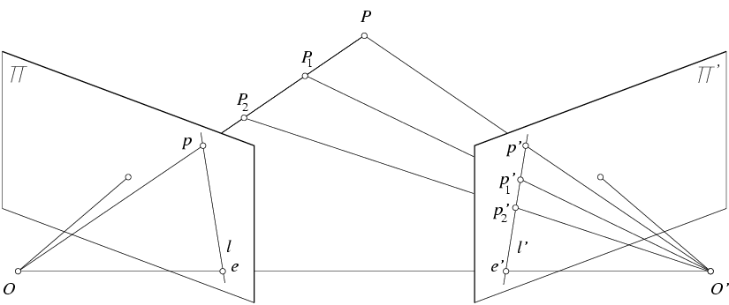
Epipolar constraint
X
x
x’
If we observe a point x in one image, where can the corresponding point x’ be in the other image?

Slide 27
Epipolar constraint
X
X
X
x
x’
x’
x’
Potential matches for x have to lie on the corresponding
epipolar line l’.
Potential matches for x’ have to lie on the corresponding
epipolar line l.

Slide 28
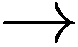
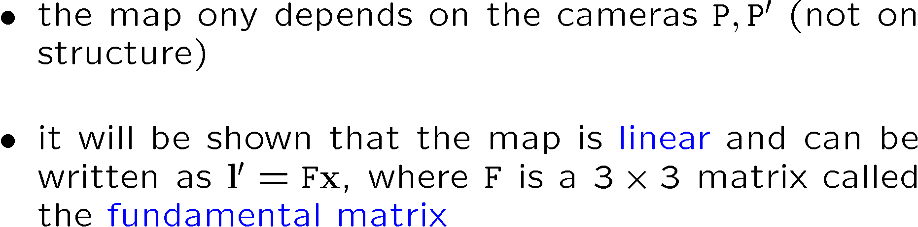
Algebraic representation of epipolar geometry
We know that the epipolar geometry defines a mapping
x l/
point in first image
epipolar line in second image

Slide 29
Matrix form of cross product

Slide 30
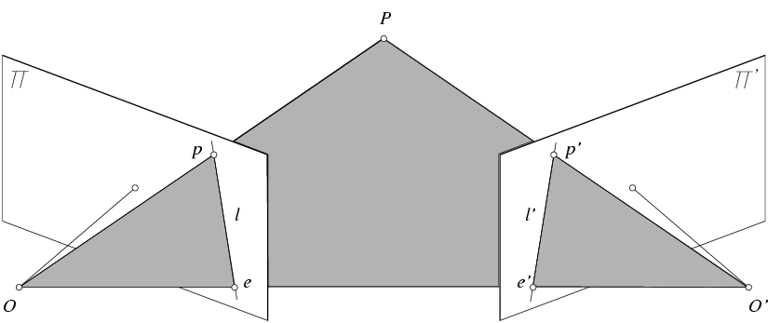
Epipolar constraint: Calibrated case
X
x
x’
Intrinsic and extrinsic parameters of the cameras are known, world coordinate system is set to that of the first camera
Then the projection matrices are given by K[I | 0] and K’[R | t]
We can multiply the projection matrices (and the image points) by the inverse of the calibration matrices to get normalized image coordinates:

Slide 31
Epipolar constraint: Calibrated case
X
= (x,1)^{T}
x
x’ = Rx+t
t
R
The vectors Rx, t, and x’ are coplanar
Notes:
X’ is X in the second camera’s coordinate system
We can identify the non-homogeneous 3D vectors X and X’ with the homogeneous coordinate vectors x and x’ of the projections of the two points into the two respective images

Slide 32
Epipolar constraint: Calibrated case
X
x
x’ = Rx+t
Recall:
The vectors Rx, t, and x’ are coplanar

Slide 33
Epipolar constraint: Calibrated case
X
x
x’ = Rx+t
Essential Matrix
(Longuet-Higgins, 1981)
The vectors Rx, t, and x’ are coplanar

Slide 34
Epipolar constraint: Calibrated case
X
x
x’
E x is the epipolar line associated with x (l' = E x)
Recall: a line is given by ax + by + c = 0 or

Slide 35
Epipolar constraint: Uncalibrated case
X
x
x’
The calibration matrices K and K’ of the two cameras are unknown
We can write the epipolar constraint in terms of unknown normalized coordinates:

Slide 36
Epipolar constraint: Uncalibrated case
X
x
x’
Fundamental Matrix
(Faugeras and Luong, 1992)

Slide 37
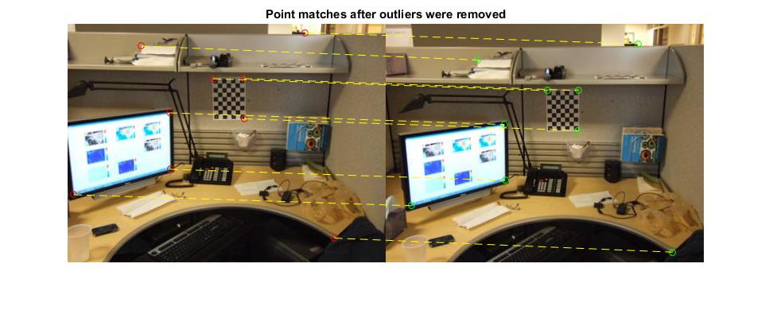
Estimating the fundamental matrix

Slide 38
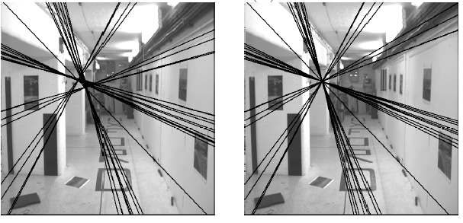
The eight-point algorithm
Solve homogeneous linear system using eight or more matches
Enforce rank-2 constraint (take SVD of F and throw out the smallest singular value)

Slide 39
Problem with eight-point algorithm

Slide 40
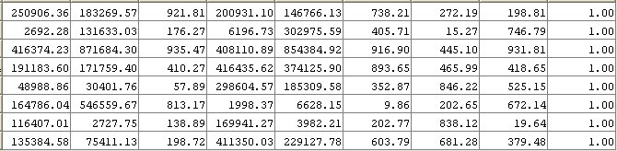
Problem with eight-point algorithm
Poor numerical conditioning
Can be fixed by rescaling the data

Slide 41
The normalized eight-point algorithm
(Hartley, 1995)
Center the image data at the origin, and scale it so the mean squared distance between the origin and the data points is 2 pixels
Use the eight-point algorithm to compute F from the normalized points
Enforce the rank-2 constraint (for example, take SVD of F and throw out the smallest singular value)
Transform fundamental matrix back to original units: if T and T’ are the normalizing transformations in the two images, than the fundamental matrix in original coordinates is T’^{T} F T

Slide 42
Nonlinear estimation
Linear estimation minimizes the sum of squared algebraic distances between points x’_{i} and epipolar lines F x_{i} (or points x_{i} and epipolar lines F^{T}x’_{i}):
Nonlinear approach: minimize sum of squared geometric distances
x_{i}

Slide 43
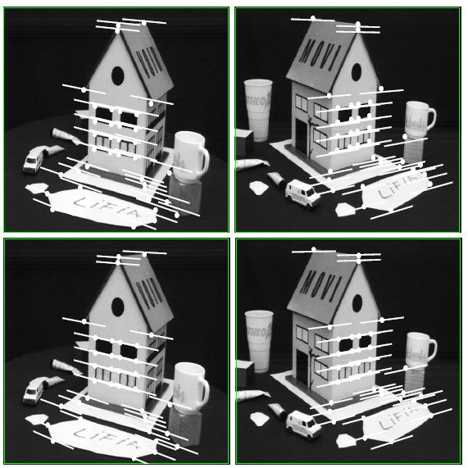
Comparison of estimation algorithms
 | 8-point | Normalized 8-point | Nonlinear least squares
Av. Dist. 1 | 2.33 pixels | 0.92 pixel | 0.86 pixel
Av. Dist. 2 | 2.18 pixels | 0.85 pixel | 0.80 pixel

Slide 44
Stereo correspondence algorithms

Slide 45
Stereo correspondence algorithms

Slide 46
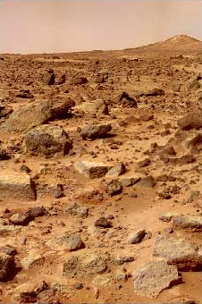
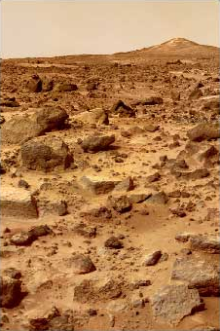
Binocular stereo
Given a calibrated binocular stereo pair, fuse it to produce a depth image
Where does the depth information come from?

Slide 47
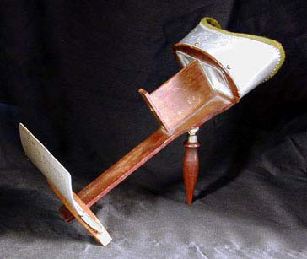
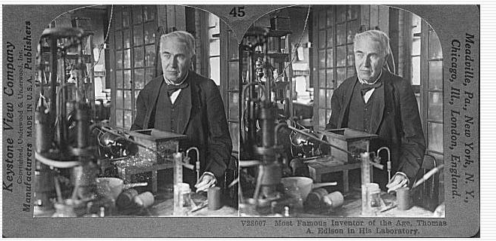
Binocular stereo
Given a calibrated binocular stereo pair, fuse it to produce a depth image
Humans can do it
Stereograms: Invented by Sir Charles Wheatstone, 1838

Slide 48
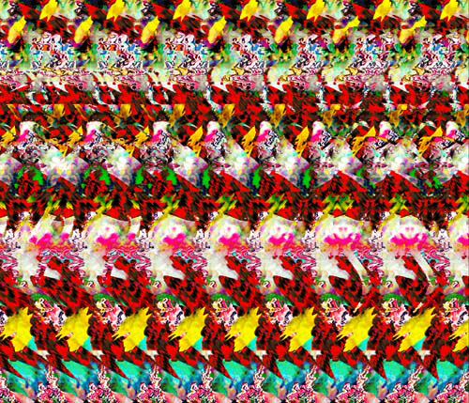
Binocular stereo
Given a calibrated binocular stereo pair, fuse it to produce a depth image
Humans can do it
Autostereograms: www.magiceye.com

Slide 49
Stereo
Assumes (two) cameras.
Known positions.
Recover depth.

Slide 50
Simplest Case: Parallel images
Image planes of cameras are parallel to each other and to the baseline
Camera centers are at same height
Focal lengths are the same

Slide 51
Simplest Case: Parallel images
Image planes of cameras are parallel to each other and to the baseline
Camera centers are at same height
Focal lengths are the same
Then epipolar lines fall along the horizontal scan lines of the images

Slide 52
Simplest Case
Image planes of cameras are parallel.
Focal points are at same height.
Focal lengths same.
Then, epipolar lines are horizontal scan lines.

Slide 53
Epipolar Geometry for Parallel Cameras
f
f
O_{l}
O_{r}
T
e_{l}
e_{r}
P
Epipoles are at infinite
Epipolar lines are parallel to the baseline

Slide 54
We can always achieve this geometry with image rectification
Image Reprojection
reproject image planes onto common plane parallel to line between optical centers
Notice, only focal point of camera really matters
(Seitz)

Slide 55
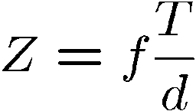
Let’s discuss reconstruction with this geometry before correspondence, because it’s much easier. blackboard
P
Z
Disparity:
x_{l}
x_{r}
f
p_{l}
p_{r}
O_{l}
O_{r}
T
Then given Z, we can compute X and Y.
T is the stereo baseline
d measures the difference in retinal position between corresponding points

Slide 56
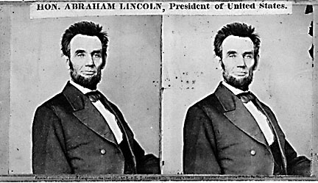
Using these constraints we can use matching for stereo
For each epipolar line
For each pixel in the left image
compare with every pixel on same epipolar line in right image
pick pixel with minimum match cost
This will never work, so:
Improvement: match windows

Slide 57
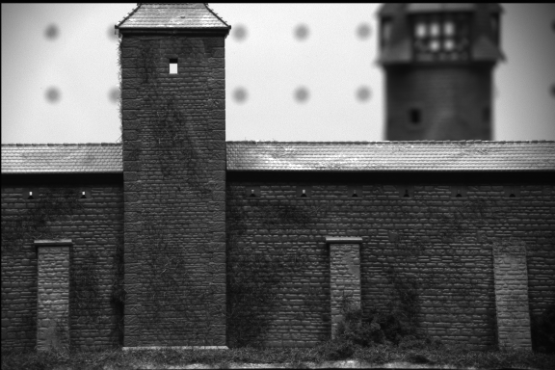
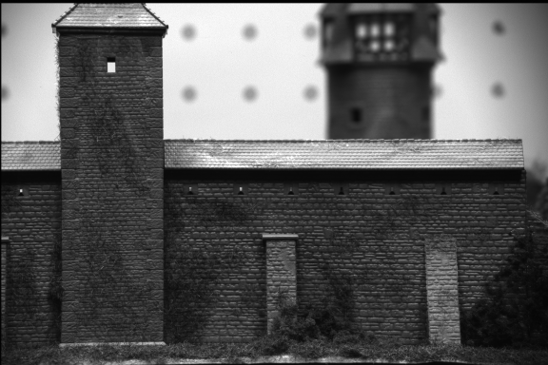
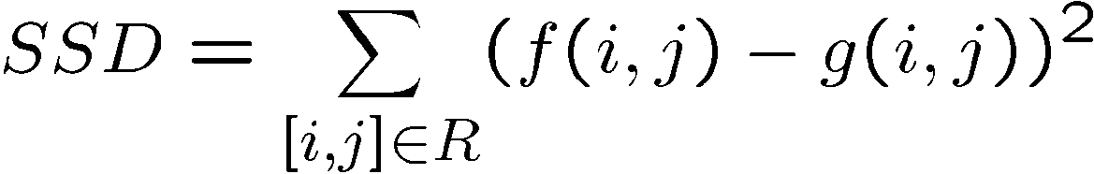
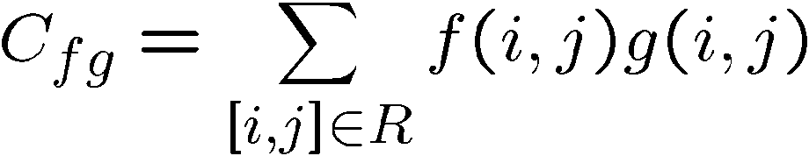
Comparing Windows:
?
=
f
g
Most
popular
For each window, match to closest window on epipolar line in other image.

Slide 58
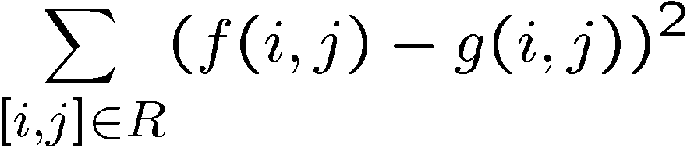
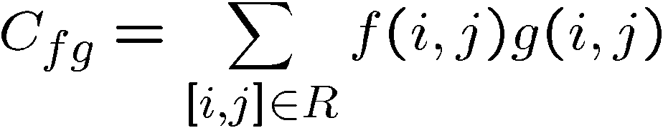
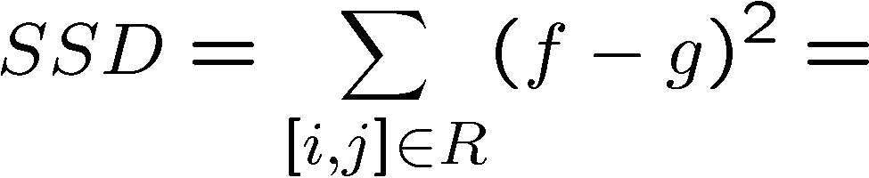
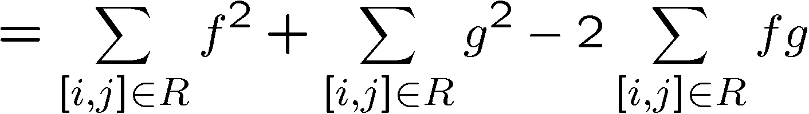
Minimize
Sum of Squared
Differences
Maximize
Cross correlation
It is closely related to the SSD:

Slide 59

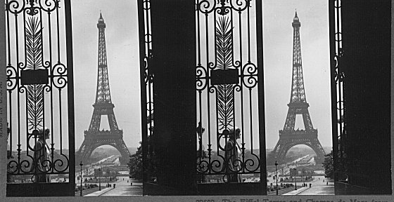
Failures of correspondence search
Textureless surfaces
Occlusions, repetition
Non-Lambertian surfaces, specularities

Slide 60
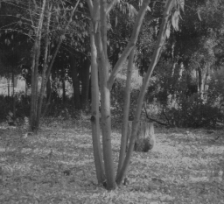
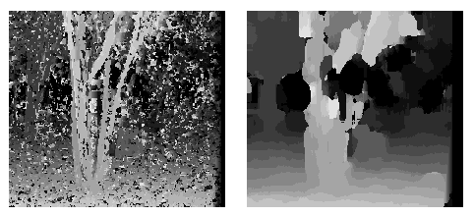
Effect of window size
W = 3
W = 20
Smaller window
More detail
More noise
Larger window
Smoother disparity maps
Less detail
Notes:
smaller window: more detail, more noise
bigger window: less noise, more detail

Slide 61
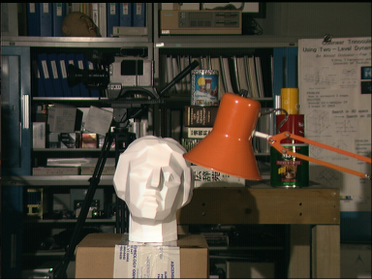

Stereo results
Data from University of Tsukuba
Scene
Ground truth
(Seitz)

Slide 62
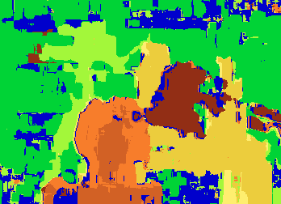

Results with window correlation
Window-based matching
(best window size)
Ground truth
(Seitz)

Slide 63
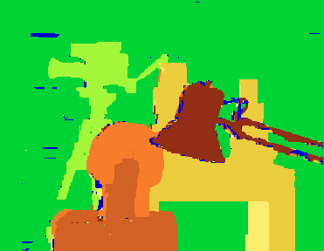
Better methods exist...
Graph cuts
Ground truth
Y. Boykov, O. Veksler, and R. Zabih, Fast Approximate Energy Minimization via Graph Cuts, PAMI 2001
For the latest and greatest: http://www.middlebury.edu/stereo/

Slide 64
How can we improve window-based matching?
The similarity constraint is local (each reference window is matched independently)
Need to enforce non-local correspondence constraints

Slide 65
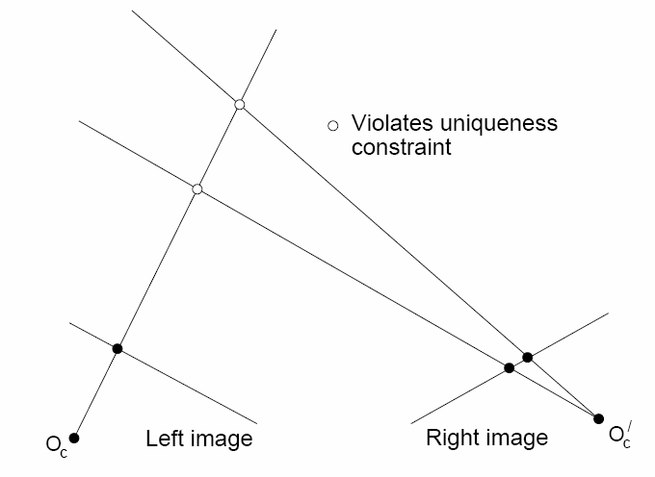
Non-local constraints
Uniqueness
For any point in one image, there should be at most one matching point in the other image

Slide 66
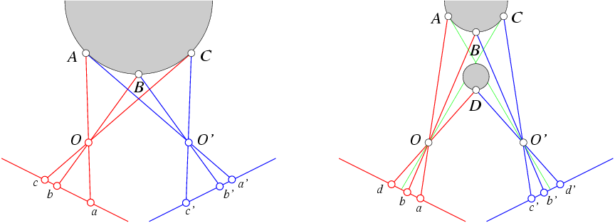
Non-local constraints
Uniqueness
For any point in one image, there should be at most one matching point in the other image
Ordering
Corresponding points should be in the same order in both views

Slide 67
Non-local constraints
Uniqueness
For any point in one image, there should be at most one matching point in the other image
Ordering
Corresponding points should be in the same order in both views
Ordering constraint doesn’t hold

Slide 68
Non-local constraints
Uniqueness
For any point in one image, there should be at most one matching point in the other image
Ordering
Corresponding points should be in the same order in both views
Smoothness
We expect disparity values to change slowly (for the most part)

Slide 69
Ordering constraint enables dynamic programming.
If we match pixel i in image 1 to pixel j in image 2, no matches that follow will affect which are the best preceding matches.
Example with pixels (a la Cox et al.).

Slide 70
Smoothness constraint
Smoothness: disparity usually doesn’t change too quickly.
Unfortunately, this makes the problem 2D again.
Solved with a host of graph algorithms, Markov Random Fields, Belief Propagation, ….

Slide 71
Scanline stereo
Try to coherently match pixels on the entire scanline
Different scanlines are still optimized independently
Left image
Right image

Slide 72
“Shortest paths” for scan-line stereo
Left image
Right image
Right
occlusion
q
Left occlusion
correspondence
t
s
p
Can be implemented with dynamic programming
Ohta & Kanade ’85, Cox et al. ‘96
Slide credit: Y. Boykov

Slide 73
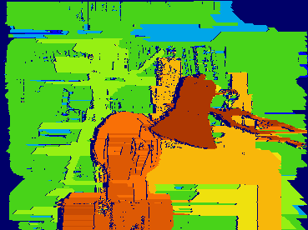
Coherent stereo on 2D grid
Scanline stereo generates streaking artifacts
Can’t use dynamic programming to find spatially coherent disparities/ correspondences on a 2D grid

Slide 74
Stereo matching as energy minimization
I₁
I₂
D
W₁(i )
W₂(i+D(i ))
D(i )
data term
smoothness term
Energy functions of this form can be minimized using graph cuts
Y. Boykov, O. Veksler, and R. Zabih, Fast Approximate Energy Minimization via Graph Cuts, PAMI 2001

Slide 75
Summary
First, we understand constraints that make the problem solvable.
Some are hard, like epipolar constraint.
Ordering isn’t a hard constraint, but most useful when treated like one.
Some are soft, like pixel intensities are similar, disparities usually change slowly.
Then we find optimization method.
Which ones we can use depends on which constraints we pick.

